Slide 1

CREATE A WEBSITE FOR AN ONLINE SHOPPING SYSTEM FOR FASHION WEAR
SUBMITTED BY:
P.SANDHYA MADHURI(192211093)
N.KAMALANI(192210354)

Slide 2
PROBLEM STATEMENT
This project aims to develop an online shopping platform specifically for fashion wear, addressing these challenges to enhance customer satisfaction and engagement.
Many existing platforms face challenges in providing a seamless user experience, maintaining up-to-date fashion trends, offering personalized recommendations, and ensuring secure transactions.
Enhanced customer loyalty and retention due to the availability of promotions and loyalty programs.
Streamlined inventory management for retailers, resulting in improved stock handling and reduced operational costs .
A secure and trustworthy platform that protects customer data and builds confidence in online shopping.

Slide 3
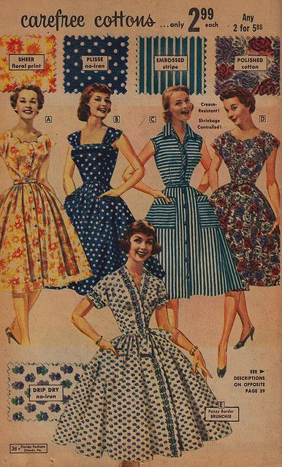

ABSTRACT
Online Shopping is a lifestyle, e-commerce web applications, which provides various electronic and lifestyle products
This project allows viewing various products available enables registered users to purchase desired products instantly using now cash on delivery payment system can place ordered by using option
In order to develop an e-commerce website, a number of technologies must be studied and understood. This is a project with the objective to develop a basic websites where a consumer is provided with a shopping cart and application
In today’s fast changing business environment, it is extremely important to be able to respond to client needs in the most effective and timely manner

Slide 4
EXISTING SYSTEM
The current manual payment methods for online purchases are riddled with inefficiencies that make it difficult for customers to have a seamless shopping experience.
Due to the manual entry of payment details, which slows down transaction completion and increases the likelihood of abandoned carts, lengthy processing delays during checkout are a regular issue.
human mistake can result in inaccurate charges, disputes, and possible revenue losses for online retailers when using manual payment entry methods.
These issues can be resolved by implementing an automated online payment system, which will guarantee quicker processing times, lower error rates, and offer a more practical and safe payment method.
PROPOSED SYSTEM
The proposed Online Shopping System is designed to enhance efficiency and user convenience by enabling secure online purchases and order management.
Users can register, browse products, make payments, and access detailed reports of their transactions, with total amounts automatically calculated based on selected items.
The system features user registration and authentication, ensuring secure access and data protection.
It includes a responsive design for compatibility across devices and utilizes a robust architecture with a MySQL database, PHP for server-side processing, and HTML, CSS, and JavaScript for a user-friendly interface.

Slide 5
MODULE DESCRIPTION
To develop the Online Shopping System, we will divide the project into distinct modules, each responsible for specific functionalities.
By creating individual functions for every operation and unifying them, we can ensure modularity, maintainability, and scalability.
Provides users with an introductory overview of the online shopping platform.
Offers detailed information about the online shopping platform and its mission.
user sign-up, login, and logout functionalities. It supports various authentication methods (email/password, social media logins).
Allows users to update personal information, manage shipping addresses, and view order history .
Provides features for password recovery, two-factor authentication, and account security alerts.
Allows users to add, remove, and update items, including quantity changes.

Slide 6
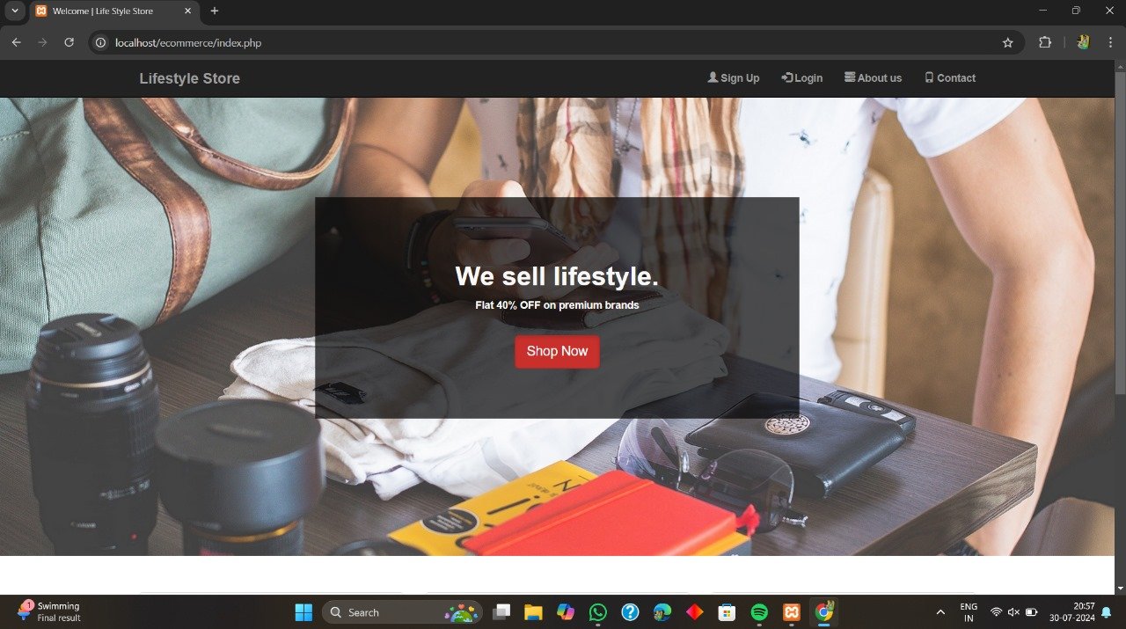
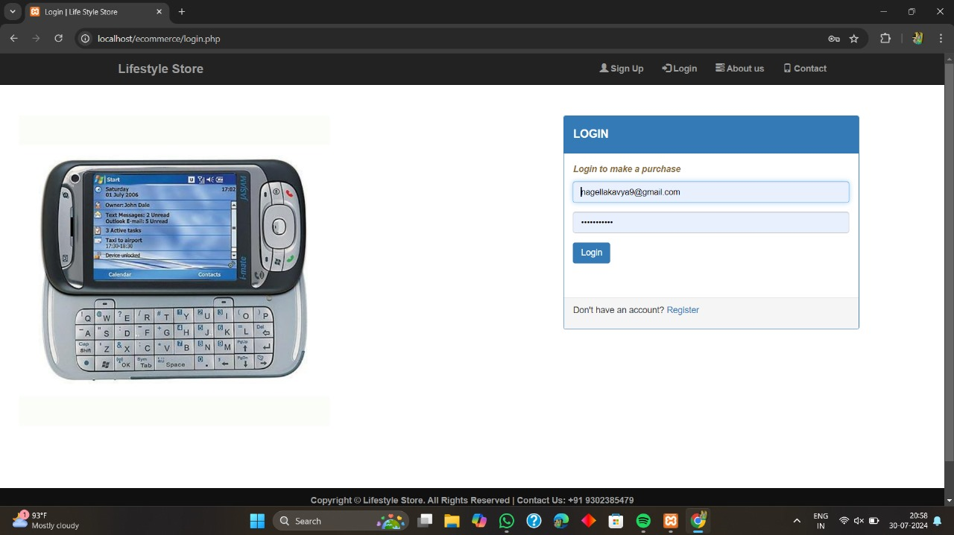
SCREENSHOTS
FIG.1.HOME PAGE
FIG.2. LOGIN PAGE

Slide 7
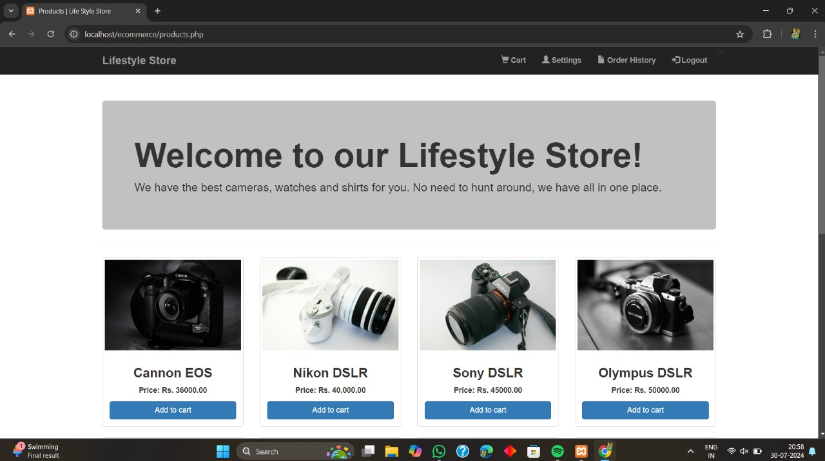
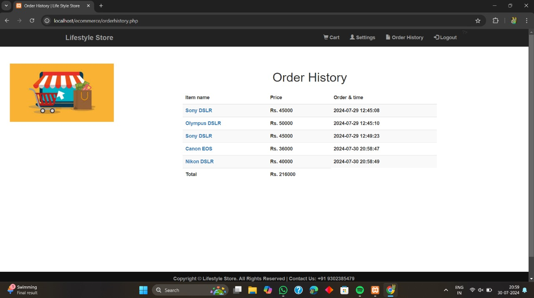
FIG.3.PRODUCTS PAGE
FIG.4.ORDER HISTORY

Slide 8
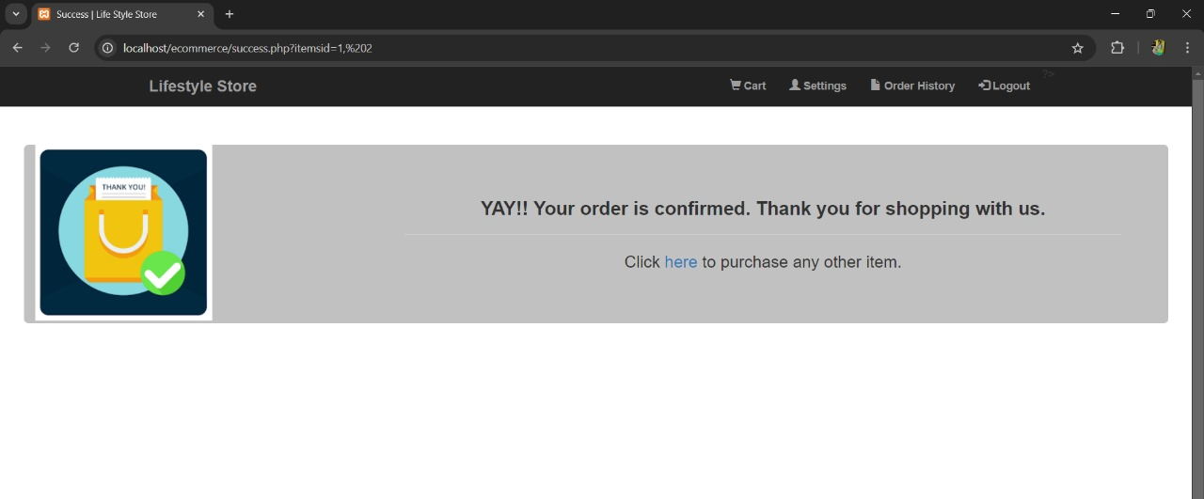
FIG.5. ORDER CONFIRMATION PAGE

Slide 9
CONCLUSION
The WEB BASED ONLINE SHOPPING SYSTEM is developed with the help of different tools such as HTML, CSS, MYSQL
Online shopping is the best way to purchase any item but be careful because there may be some fake products on different sites
We can purchase only those items which can be recognised easily that items is fake or not or choose according rating for buyers
On our site you will get items genuine and trusty, check once our website before buy anywhere
The site provides strong features to make the process easier, whether it's planning future purchases, keeping track of seasonal trends, or outfit organization

Slide 10

FUTURE ENHANCEMENT
As the "Online Shopping System" evolves, numerous potential enhancements might be made to increase the user experience and engagement.
Integration of advanced search and filtering tools is one significant improvement. Making it simpler to locate pertinent products fast is one of the ways this is accomplished.
Users can search for products based on particular criteria like category, price range, brand, and customer ratings. Further improving the usefulness of the program is the incorporation of real-time inventory updates and notifications, which can notify users of any changes, promotions.
Moreover, transaction security and user trust can be increased by putting in place a reliable and fast payment gateway with a variety of payment choices.
The "Online Shopping System" can continue to be a dependable, effective, and user-friendly platform for handling online purchases if these aspects are consistently improved.

Slide 11
REFERENCES
Gefen, D., Karahanna, E., & Straub, D. W. (2003). Trust and TAM in online shopping: An integrated model. MIS Quarterly, 27(1), 51-90.
Kim, D. J., Ferrin, D. L., & Rao, H. R. (2008). A trust-based consumer decision-making model in electronic commerce: The role of trust, perceived risk, and their antecedents. Decision Support Systems, 44(2), 544-564.
Koufaris, M. (2002). Applying the technology acceptance model and flow theory to online consumer behavior. Information Systems Research, 13(2), 205-223.
Jarvenpaa, S. L., Tractinsky, N., & Vitale, M. (2000). Consumer trust in an internet store. Information Technology and Management, 1(1-2), 45-71.
Pavlou, P. A. (2003). Consumer acceptance of electronic commerce: Integrating trust and risk with the technology acceptance model. International Journal of Electronic Commerce, 7(3), 101-134.
Cheung, C. M., & Lee, M. K. (2005). Consumer satisfaction with internet shopping: A research framework and propositions for future research. Proceedings of the 7th international conference on Electronic commerce, 327-334.
Chen, L., Gillenson, M. L., & Sherrell, D. L. (2002). Enticing online consumers: An extended technology acceptance perspective. Information & Management, 39(8), 705-719.
Huang, Z., & Benyoucef, M. (2013). From e-commerce to social commerce: A close look at design features. Electronic Commerce Research and Applications, 12(4), 246-259.
Li, N., & Zhang, P. (2002). Consumer online shopping attitudes and behavior: An assessment of research. AMCIS 2002 Proceedings, 74.
Ha, S., & Stoel, L. (2009). Consumer e-shopping acceptance: Antecedents in a technology acceptance model. Journal of Business Research, 62(5), 565-571.

Slide 12

Shop with Confidence
Browse
1
Explore our curated collection of the latest fashion trends and essentials.
2
Add to Cart
Select your desired items and add them to your shopping cart with ease.
3
Checkout
Securely complete your purchase and receive your items at your doorstep.

Slide 13


THANK YOU

